Slide 1

DJANGO
BUILD AN ORGANISED
WEB APPLICATION

Slide 2
CONTENTS
Introduction to Django Web Framework
Django Features
Django Structure
Django Installation
Django WorkFlow
Django MVT
Django Project

Slide 3
WHAT IS DJANGO?
Django is a Web Application Framework written in Python Programming Language.
Django is a highly popular, free open-source high-level Python web framework.
It follows the MVT (Model-View-Template) Architecture and helps in the Development and Maintenance of High Quality Web Applications.
It takes less time to build application after collecting client requirement.

Slide 4
FEATURES OF DJANGO
Rapid Development
Secure
Scalable
Fully loaded
Versatile
Open Source
Vast and Supported Community

Slide 5
DJANGO STRUCTURE
Loosely Coupled: Django aims to make each element of its stack independent of the others.
Less Coding: Less code so in turn a quick development.
Don't Repeat Yourself (DRY): Everything should be developed only in exactly one place instead of repeating it again and again.
Fast Development: Django's Structure is to do all it can to facilitate hyper-fast development.
Clean Design: Django strictly maintains a clean design throughout its own code and makes it easy to follow best web-development practices

Slide 6
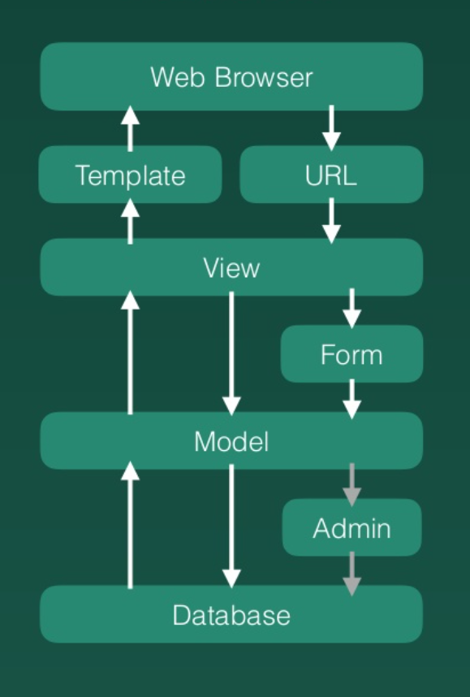
DJANGO WORKFLOW

Slide 7
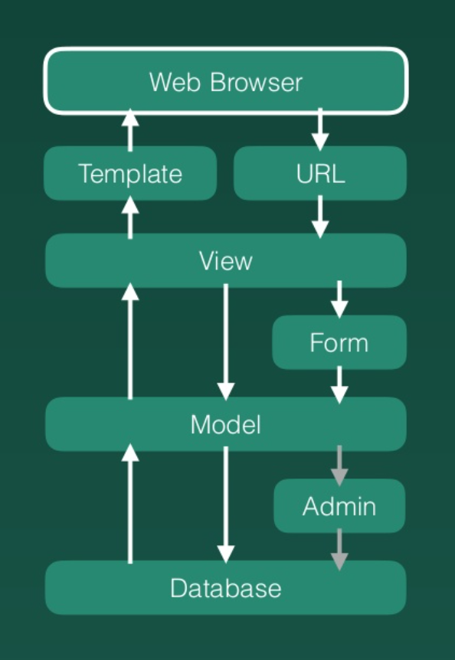
WEB BROWSER
Web Browser is what users actually see
It responds to what users do when they
Click
Type
Press enter

Slide 8
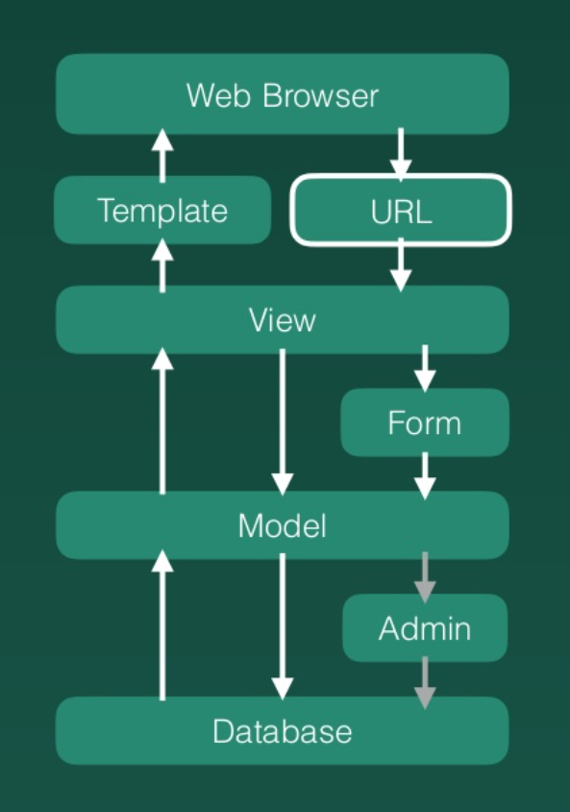
URL
URL is often referred as the web address.
It provides mapping to view.
What is mapping?
The act of assigning functions to urls.

Slide 9
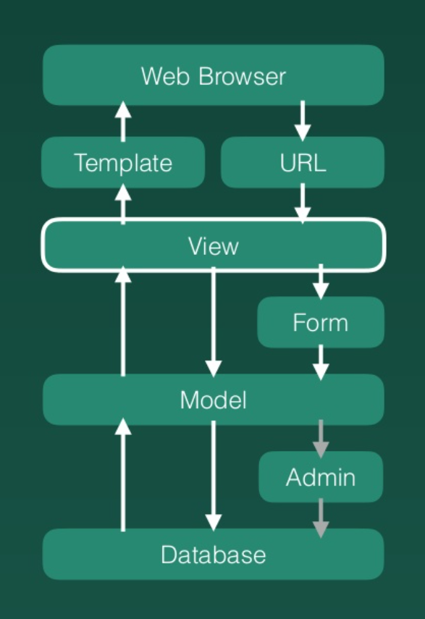
VIEW
View is where all the functions are written.
It provides content to template.
It gets information from model before rendering content.
It puts information into model and into database through form.

Slide 10
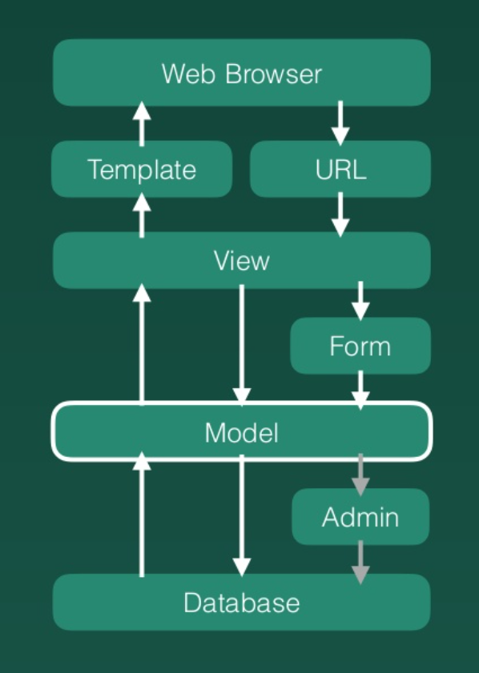
TEMPLATE
Template is the place you systematically store all of your HTML files.
You will have a “Static Folder” to store other CSS files, Java Script files or Images

Slide 11
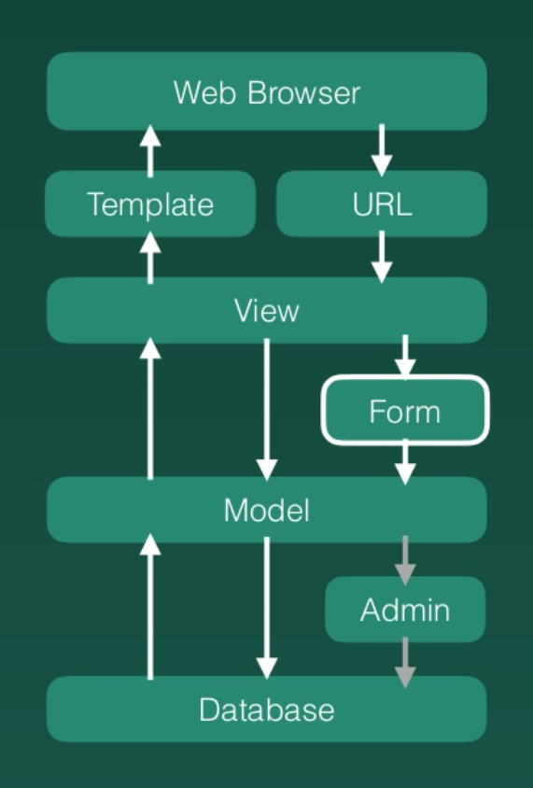
FORM
There are two types of Forms
HTML Form
Django Form
HTML FORM: It consists of Input Element, Check Box, Submit Button, Radio Button etc.
DJANGO FORM: It aims to Fetch Data from HTML Form and helps to connect to Model.

Slide 12
MODEL
Model Describes The Structure Of an Object You Want To Store In The Database.
It Goes Straight To Database And Create, Edit & Request Information As You Wish

Slide 13
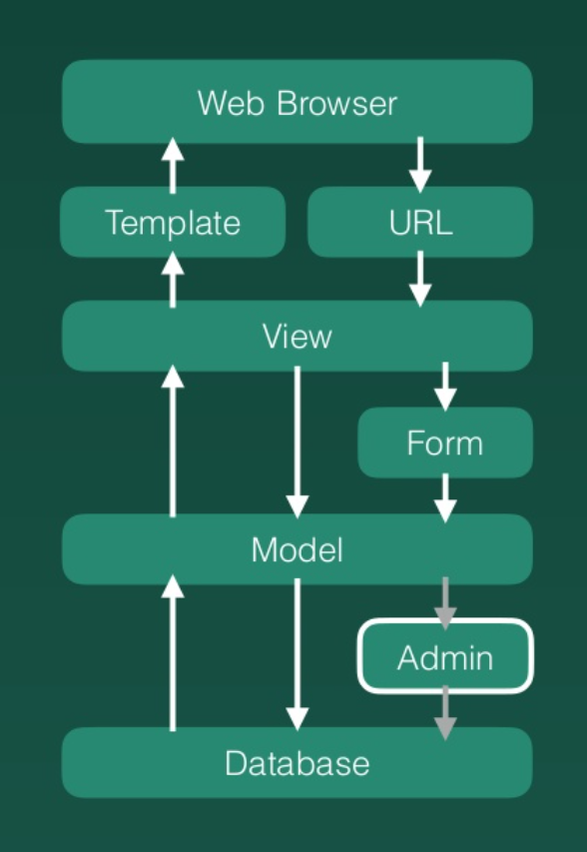
ADMIN
It Helps To Register The Object In Your Model So You Can Manage Data In Database
The Registration Has To Be Done In The First Place

Slide 14
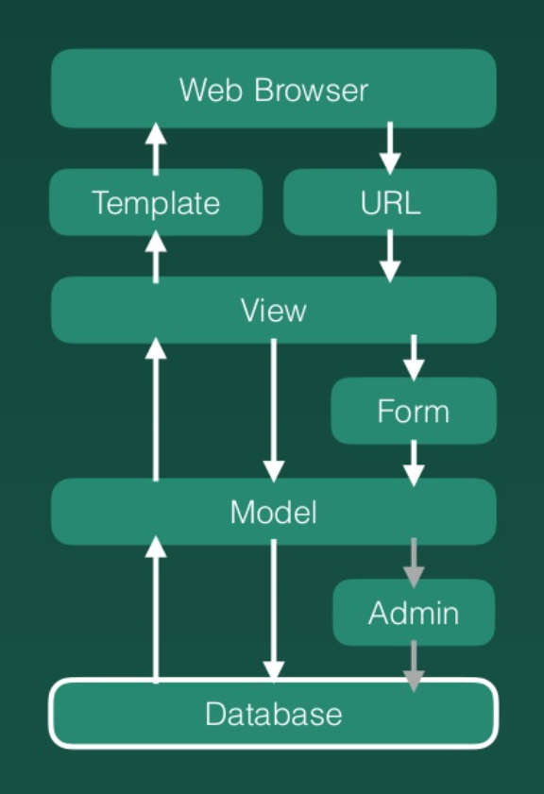
DATABASE
A database is a collection of data provided with a backend platform for easy management.

Slide 15
DJANGO MVT
The MVT (Model View Template) is a software design pattern. It is a collection of three important components Model View and Template.
Model: The Model helps to handle database. It is a data access layer which handles the data.
Template: The Template is a presentation layer which handles User Interface part completely.
View: The View is used to execute the business logic and interact with a model to carry data and renders a template.

Slide 16
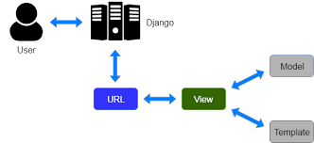
MVT ARCHIECHTURE IN DJANGO

Slide 17
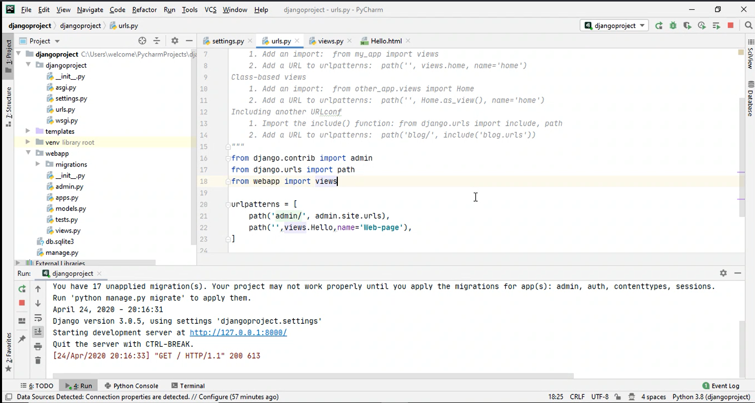
DJANGO SAMPLE PROJECT

Slide 18
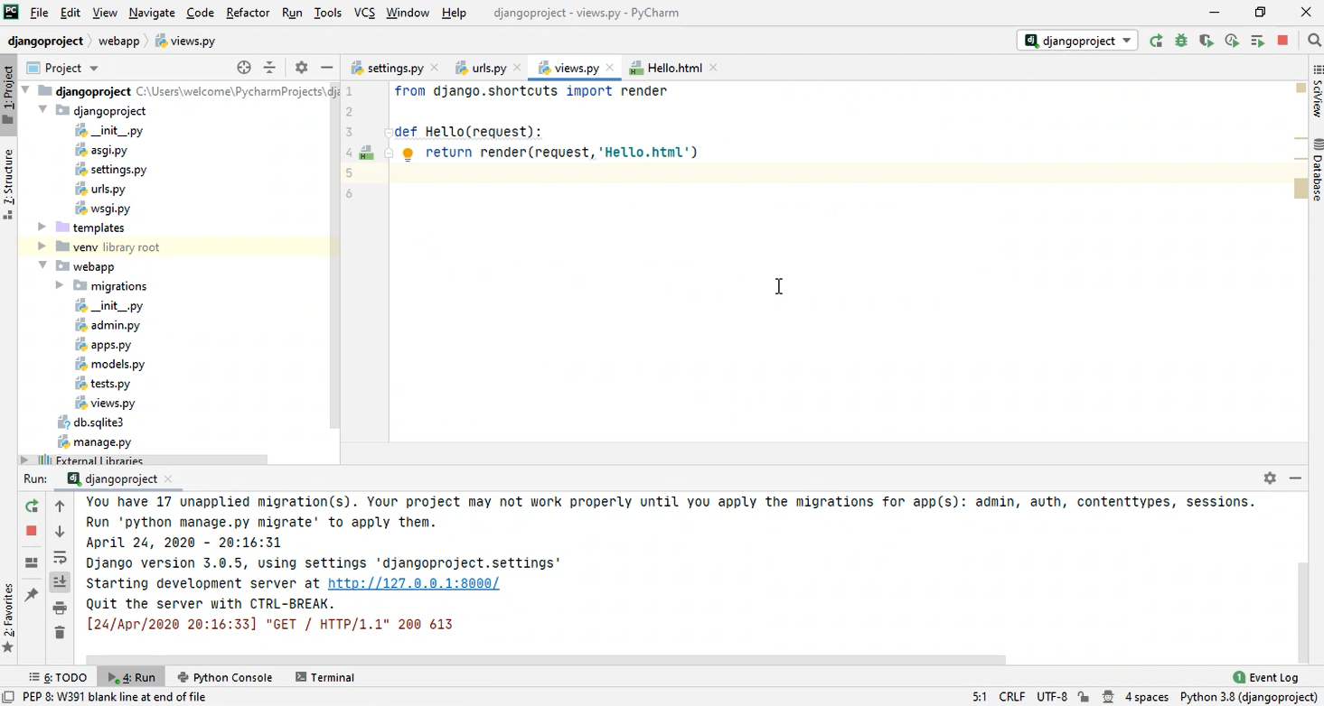

Slide 19
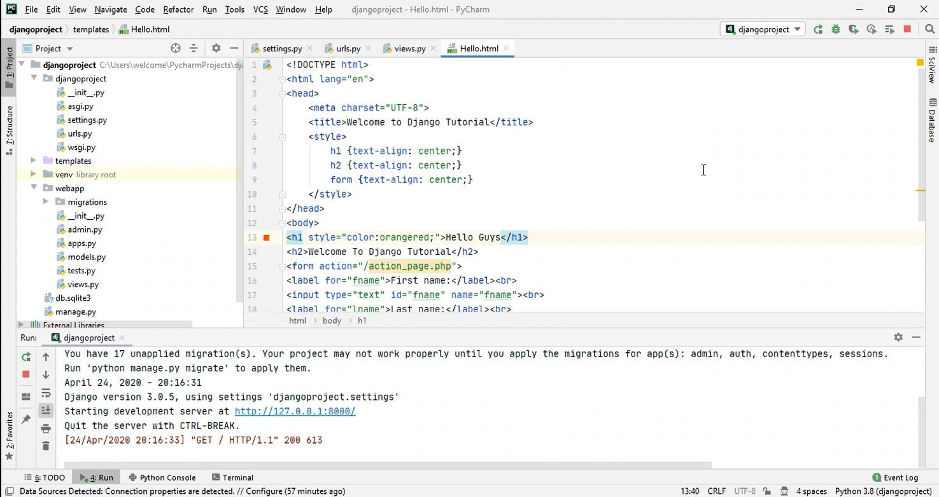

Slide 20
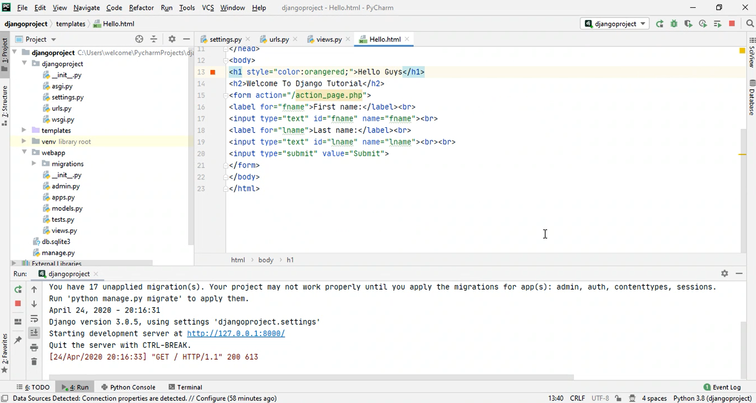

Slide 21
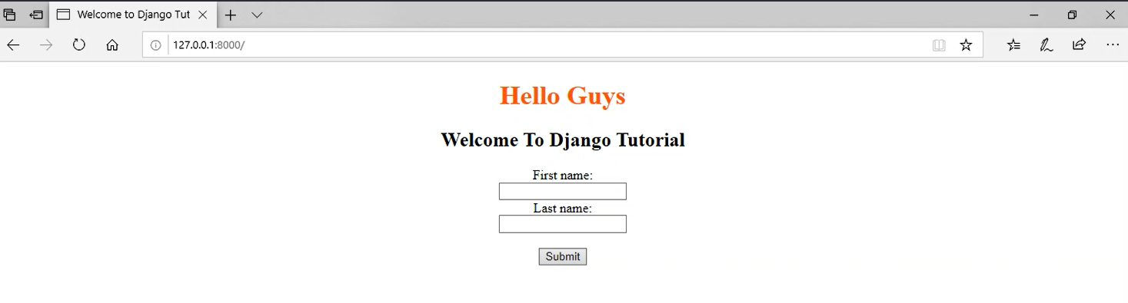
OUTPUT OF THE PROJECT

